Slide 1


Slide 2
DEFINATION OF A COMPUTER
A computer is an electronic device that manipulates information, or "data." It has the ability to store, retrieve, and process data.
uses
Typing documents
send email
browse the internet
Accounting
database management
Playing games etc

Slide 3
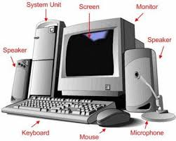
PARTS OF A COMPUTER

Slide 4
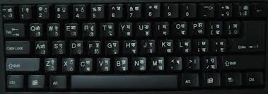
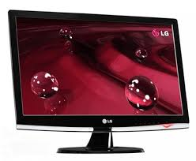
Keyboard
Monitor

Slide 5
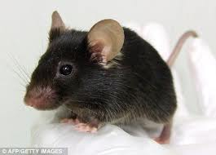
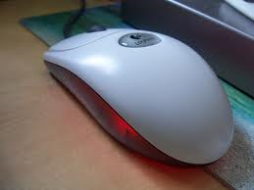
Real Mouse
Computer Mouse

Slide 6
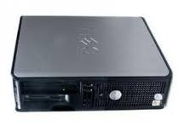
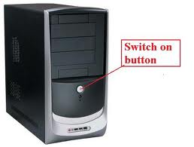
Types of System Units
Tower System Unit
Desktop System Unit

Slide 7
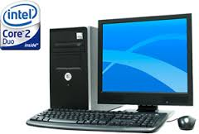
COMPLETE COMPUTER SYSTEM

Slide 8
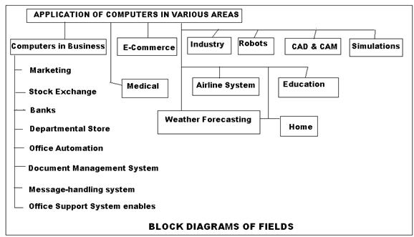
AREAS WHERE COMPUTERS ARE USED

Slide 9
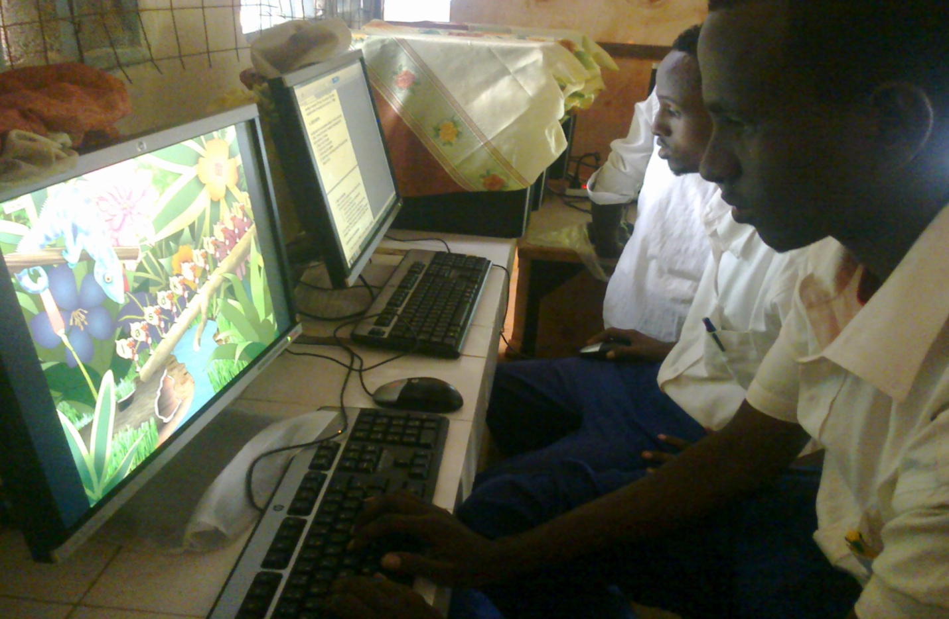
Learning in Schools

Slide 10
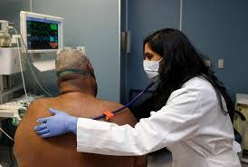
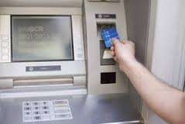
HOSPITALS
BANKS

Slide 11
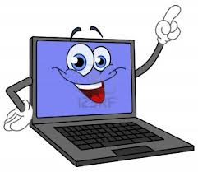
THE END

Slide 12
CLASSIFICATION ACCORDING TO SIZE
SUPERCOMPUTERS
Super computers are the fastest, most-powerful and most expensive computers.
It has the ability to recover automatically from failures.
It has the ability to support several Giga Bytes of RAM.
They have multiple processors (or CPUs) that process multiple instructions at a time.
They are widely used in scientific applications such as aerodynamic design and simulation, processing of geological data.
One of the most powerful supercomputers today is "The Cray-2" and Some others are CRAY 1, CRAY - MP, SX-2, HITAC S-300, etc.

Slide 13
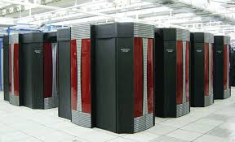
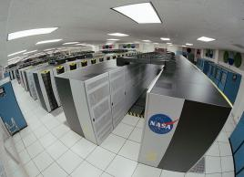

Slide 14
2. Mainframe Computer
A mainframe computer is slower, less powerful and less expensive than supercomputers.
Very large in size; it can occupy an entire room
Mainframes process several million instructions per second (MIPS). More than 1,000 remote workstations can be accommodated by a typical mainframe computer.
Mainframes are used by banks and many businesses to update inventory, etc.
Many modern mainframes have multiprocessing capabilities.

Slide 15
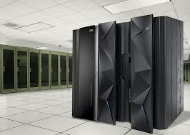
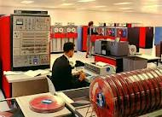
Diagram of mainframe computers

Slide 16
3. Minicomputers
These are also general purpose computers, smaller than mainframe computer. They are medium sized-computer.
They have slower operating speed, smaller backup storage, limited hardware and less memory than mainframes.
They are well adapted for functions such as accounting, word processing, data base management and statistical packages for social sciences.
They have more than 50 terminals and large storage capacity devices than micro computers but smaller than mainframe computers. E.g. Prime 9755

Slide 17
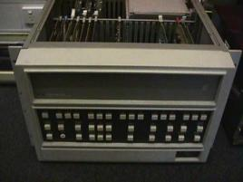
A diagram of a minicomputer

Slide 18
4. Microcomputers
A microcomputer is the smallest, least expensive of all the computers.
They have smallest memory and less power
They are also called personal computers.
The most common type of microcomputer is a desktop computer, which is a non-portable personal computer.
Others are laptops, smartphones, tablets, mobile phones, Personal Digital Assistants(PDA) which are portable PC’s.s

Slide 19
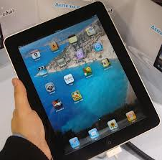
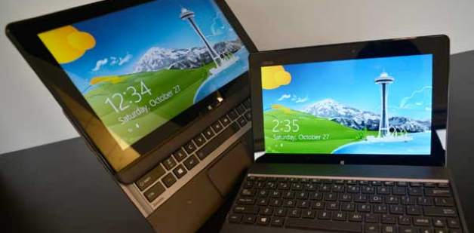
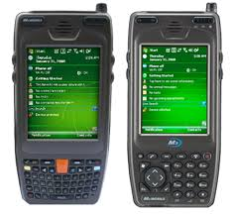
tablet
Laptop
PDA

Slide 20
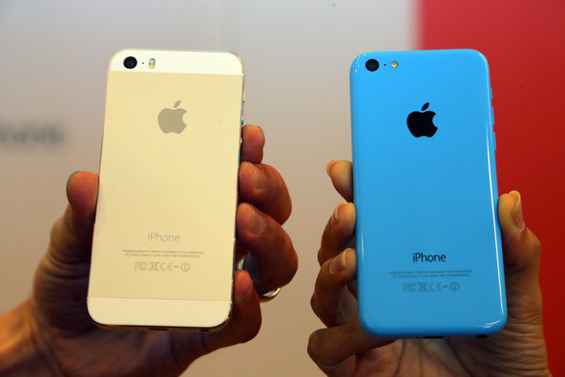
I phone 5-one of the latest phones

Slide 21
CLASSIFIATION ACCORDING TO PURPOSE/FUNCTIONALITY
General Purpose Computers: - These are multipurpose Computers capable of solving a wide range of problems (tasks).
They can be used in and for various aspects like drawing, calculating, designing, typing, multi-media functions, playing games etc.
Examples are the Desktop computers, Laptop, Mini Tower computers, etc

Slide 22
Special Purpose Computers: these are dedicated computers designed solely for the purpose of solving a particular problem. Examples are:
  The road Traffic Light control,
  Calculators,
  Robots (Robotics),
  Counting Machines, etc.

Slide 23
CLASSIFIATION ACCORDING TO TECHNOLOGY
a) Analog Computers:- These computers recognize data as a continuous measurement of a physical property ( voltage, pressure, speed and temperature).
Example: Automobile speedometer
b) Digital Computers:- These are high speed programmable electronic devices that perform mathematical calculations, compare values and store results. They recognize data by counting discrete signal representing either a high or low voltage state of electricity.
c) Hybrid Computers:-A computer that processes both analog and digital data.

Slide 24
CHAPTER TWO (2)
COMPUTER STUDIES

Slide 25
COMPUTER SYSTEMS
Introduction
A system is a collection of entities that collectively work together to achieve a stated goal.
An entity can be a person, place or an object.
A computer system is a collection of three entities namely hardware, software and live ware that work together to receive, process, manage and present information in a meaningful format.

Slide 26
Hardware: Physical or tangible components that make up a computer system.
They are classified into four categories namely
  Input devices
  Central Processing Unit
  Output devices
  Storage devices

Slide 27
Software: Refers to a set of instructions that direct a computer on what to do. They are mainly classified into two categories; namely system software and application software.
Live ware /Orgware/Wetware/ Gray ware: Informal terms used to refer to human beings attachment to computers. They include users, computer programmers (programs makers) and computer engineers.

Slide 28
Input Devices
Input devices convert user input which is in human readable form to machine language that a computer can process. These devices can be classified according to the methods that they use to enter data namely:
1. Keying devices
Typing is the most common way to input data. A keying device converts typed numbers,letters and special characters into machine readable form before processing takes place. The following are types of keying devices:

Slide 29
Traditional keyboards
This is the most common type of keying device. It is a full sized keyboard.
Flexible Keyboard
A flexible keyboard is a more portable that ca be folded and packed into a bag.
Ergonomic Keyboard
This keyboard is designed to provide comfort and alleviate wrist strain.
Braille keyboard
This keyboard is designed for use by the blind. It consists of keys identified by raised dots.
Keypad
A keypad is a miniature keyboard used on portable devices such as PDAs, laptops and mobile phones.

Slide 30
2. Pointing devices
Pointing devices are used for controlling a pointer cursor on the screen. They include:
a) Mouse
A mouse as is a common input device. There are different types of mouse available in the market ie
  i) Standard Mouse
The standard or traditional mouse has a ball underneath, two buttons and an optional scroll button located between the left and right buttons.

Slide 31
  ii) Optical Mouse
This does not have any moving parts. It works using a tiny digital camera to take 1,500 pictures every second of the surface on which it is resting. Interpreting the pictures indicates the direction of mouse movement hence the pointer’s position on the screen.
iii) Cordless Mouse
A wireless mouse as it is also called is powered by a battery that uses radio or infra red waves instead of being physically connected to the system unit.
b) Trackball
It works just like a mouse although the ball is located at the top. The user moves (rotates) the ball using a finger. Some keyboards come with a track ball integrated therefore no need of a mouse.

Slide 32
c) Joystick
It looks like a lever. It controls a pointer on the screen. It is meant to play computer games. It does this by varying the pressure, speed and direction of the joysticks.
d)Light Pen and stylus
A light pen operates by detecting the command or item being illuminated by it. A stylus on the other hand, is used on devices such as PDAs that recognise commands or hand written data.

Slide 33
3. Scanning Devices
Scanning means capturing data from an object and converting it into digital format, scanning can be classified according to technology used to capture data. These are
a) Optical Scanners
Optical scanners capture data using optical or light technology. A light beam passes over an object and the image is analysed by specialised software. Some examples include:
i) Optical mark recognition scanners (OMR)
OMR scanners detects marks made on a piece of paper using ink or a soft pencil by passing an infrared beam over them.
This scanner is used to mark multiple choice questions, eg KCPE

Slide 34
ii) Optical Bar Recognition (OBR)
The OBR is used to capture data coded as lines of varying thickness known as barcodes or Universal Product Code.
iii) Optical Character Recognition (OCR)
An OCR is used to read typewritten, computer-printed, or handwritten characters and transforms the images into a soft copy that can be manipulated using a word processor.
Some OCR like the flat-bed scanner can be used to capture pictures and real objects.

Slide 35
b) Magnetic Scanners
These are used to capture data written using magnetic ink or coded onto a magnetic strip. The common example is the magnetic scanner, magnetic ink character recognition (MICR) and card readers
Magnetic Ink Character Recognition (MICR)
These are used to read characters written using magnetic ink. E.g. cheque readers used in banks

Slide 36
4) Digitisers
This device is also known as graphic tablet. It allows a user to draw an image using a stylus. The image drawn does not appear on the tablet but on the computer screen.
Its mainly used by engineers.
5) Digital Cameras
These images and store them in digital form in a memory card. The picture can be edited, printed or uploaded in the internet.

Slide 37
6) Other Emerging Technologies
a) Touch Screen
This technology allows the user to enter something by touching the screen with a finger or stylus. The screen consists of infra red light crisscrossing behind it.
This light is interrupted when the user taps a location on the screen and the output is displayed on the screen.
They used are in retail stores, airports, smart phones and PDAs.

Slide 38
b) Voice Input
This is an input technology, where a microphone is used to enter data in form of speech into the computer. This method is mostly suitable for the physically challenged users.
Limitations of voice input
  Homophones – some words sound the same.
  Word separation – connected speech has to be segmented.
  Recognition is slow – the vocabulary and the speech rate, response rate is still relatively slow.
  Speaker variability – the speech, pitch, rate, rhythm, intonation, loudness and pronunciation of an individual speaker vary.
  Still at early development.
  Limited vocabularies

Slide 39
c) Interactive whiteboard
Its also known as smart board is a large interactive display that connects to a computer.
The computer display is projected onto the board’s surface, where users control the computer and write using a pen or a finger.

