Slide 2
DEFINATION OF A COMPUTER
A computer is an electronic device that manipulates information, or "data." It has the ability to store, retrieve, and process data.
uses
Typing documents
send email
browse the internet
Accounting
database management
Playing games etc

Slide 3
PARTS OF A COMPUTER

Slide 4
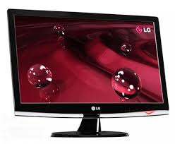
Keyboard
Monitor

Slide 5
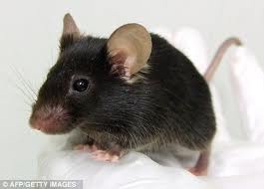
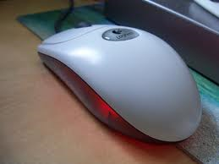
Real Mouse
Computer Mouse

Slide 6
Types of System Units
Tower System Unit
Desktop System Unit

Slide 7
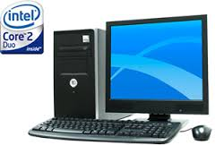
COMPLETE COMPUTER SYSTEM

Slide 8
AREAS WHERE COMPUTERS ARE USED

Slide 9
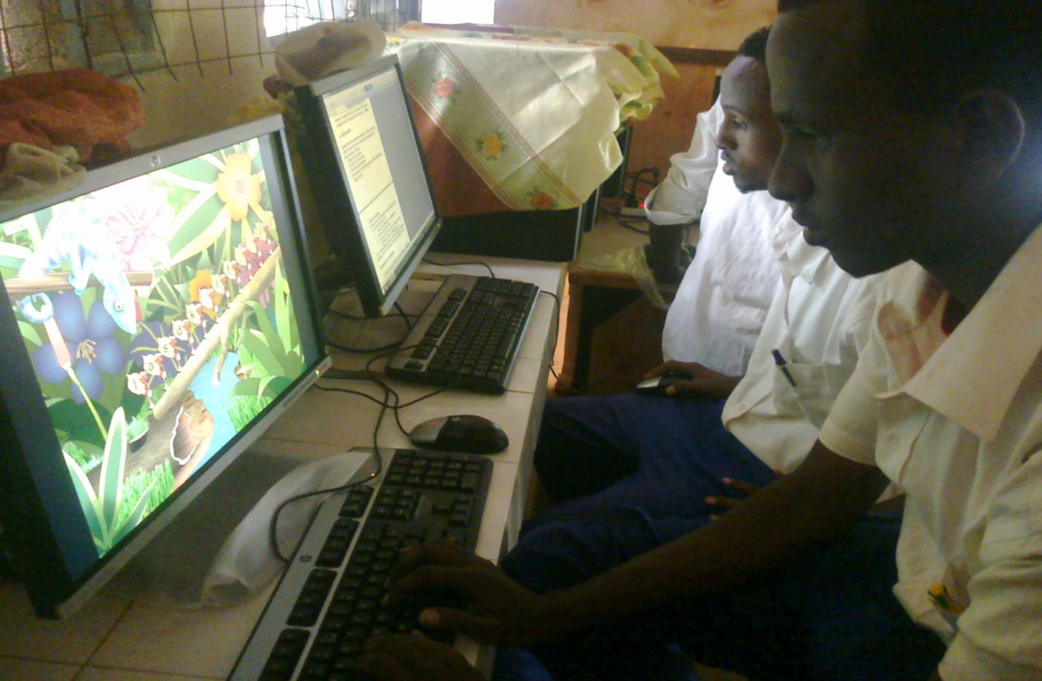
Learning in Schools

Slide 10
HOSPITALS
BANKS

Slide 11
THE END

Slide 12
SECONDARY STORAGE DEVICES AND MEDIA
Secondary storage devices are also called auxiliary storage.
They are called secondary because they are not directly accessed by the CPU.
Classification of secondary storage devices
They are classified according to:
a) Portability i.e. whether fixed or removable
b) Technology used to store and retrieve data i. e magnetic, optical magneto-optical and solid state.

Slide 13
REMOVABLE STORAGE DEVICES
These are devices that are not stored inside the computer.
A drive is a media for reading and writing data
Examples of removable storage media include the following :
Magnetic tapes
Floppy disks
Optical disks
Solid state devices

Slide 14
Magnetic storage media
1. Magnetic tapes
A magnetic tape is made using a thin ribbon of Mylar and coated with a thin layer of magnetic material made of iron oxide. Data is read or written using a tape drive. Examples include cassette tapes, cartridge tapes etc.

Slide 15
Disadvantages of using magnetic tapes
They are slow because you have to access records in a linear format. E.g. you cannot access record number 6 without moving through record 1,2 3,4 ,5 and then 6
There is space between successive data records called Inter -Record Gap (IRG)

Slide 16
2. Floppy disks
It also called a diskette. It is made up of a magnetisable iron oxide. For one to use a floppy disk the computer must have a floppy drive. Nowadays you may not see floppy disks because they are now replaced by affordable mass storage devices like flash disks and memory cards.
If the protective plastic jacket is removed the structure shown below is revealed: The floppy disk is made up of tracks and sectors. Tracks are tiny invisible concentric circles that store data. When tracks are further subdivided we get sectors

Slide 17
3. Zip disks
A zip disk resembles a floppy disk only that it has higher magnetic diskette.
A zip disk has a higher storage capacity of about 250MB. A zip disk is physically thicker.

Slide 18
4. Jaz disks
They resemble zip disks in every only that they can hold as much as 2 GB

Slide 19
5. High capacity floppy (HiFD)
High capacity disks are high capacity diskette that can store up to 200 MB data

Slide 20
6. Laser servo 120 Super-Disks
Is a diskette that resembles a diskette but it uses optical technology.
It can store up to 240MB of data.

Slide 21
Care of magnetic storage media
Do not touch the magnetic surface.
Do not bend or fold a magnetic media.
Don’t expose the media to magnetic field.
Do not drop magnetic media on the ground
Do not expose the media to excessive heat.
Do not remove a media from the drive when is still being accessed by the computer

Slide 22
7. Optical storage media
These devices are called optical because data is written and read from them using a laser beam. A laser beam is a highly concentrated light.
Reasons why optical storage media are used
They store large volumes of data
Data stored is stored more permanently

Slide 23
Examples of optical storage media
1. Compact disk (CD)
They are used to store data and information which requires a lot of space like video clips, software and sound.
One disk can hold as much as 700MB. Compact disks are classified into three forms i.e.
Compact disk read only memory (CD-ROM)
Compact disk-recordable (CD-R)
Compact disk-rewritable (CD-RW)

Slide 24
Compact disk read only memory (CD-ROM)
The data can be only be read but cannot be written on it
Also called WORM (Write Once Read Many) - mean data is written once but can be accessed many times.

Slide 25
ii) Compact disk-recordable (CD-R)
Once data is written on CD-R it becomes read only. Like CD- ROM is also called WORM (Write Once Read Many) - meaning data is written once but can be accessed many times.

Slide 26
iii. Compact disk-rewritable (CD-RW)
They allow the user to record, erase and rewrite new information just as one would with do with floppy disks.

Slide 27
ii) Digital versatile disks (DVD)
They are similar to compact disk but they have higher storage capacity of up to 17 GB.
They are normally used to record videos because they have good quality sound and picture.

Slide 28
iii) Optical card.
It resembles a MICR card but data is read and written optically on a stripe. These types of cards are used in banking and other business organizations.

Slide 29
iii) Optical tape.
Is similar to optical tape but data is stored using optical technology

Slide 30
8. Solid state storage media
Are non- volatile storage media. They do not have movable parts
Example include flash disks and memory sticks

Slide 31
FIXED STORAGE MEDIA
The main fixed storage device is the hard disk.
The hard disk is mounted inside the computer. That is why it is called fixed disk. Though it is not absolutely the case because some hard disks are removable.
The read and read head floats just above the surface of the rapidly disk to read and write data.
Most hard disks are connected to the computer using a controller. Examples of these controllers include

Slide 32
Integrated Drive Electronic (IDE)
Enhanced Drive electronic (EDE)
Attached Drive electronic (ATA)

Slide 33
Revision questions
Distinguish between primary and secondary storage devices
Differentiate between removable and fixed storage.
What is a hard disk? How does it differ from the floppy disk? State four type of optical disks
What is the difference between a DVD and CD?
Describe four precautions you consider to avoid damaging the hard disk

Slide 34
POWER SUPPLY AND PERIPHERAL DEVICE INTERFACING
1. Power supply unit and adapter
Desktop PC use power supply unit mounted on the system unit casings. You connect the power supply to the mains using a power cable. The work of the power supply unit and the adapter is to convert to AC to DC

Slide 35
Figure showing the power supply unit

Slide 36
Peripheral device interface is the process of connecting a peripheral device to a computer through ports.
Connection can be through cables or wireless.
2. Parallel interface
Parallel cables transmit information simultaneously using many wires. Example includes an 8- bit parallel cable. The parallel cables are used in connecting printers and optical scanners

Slide 38
3. Serial interface /COM /RS232
They support data transmission at a time.
It is slower than parallel port
They can support data that is connected 15m away
4. Universal serial bus (USB) interface
Universal serial is replacing parallel, serial cables and ports
It provides high speed data transmission over short distances
Examples include USB printer and USB cable used to transfer data from phones to PC etc.

Slide 39
5. Small computer system interface (SCSI)
Small computer system interface ports transmit data in parallel but are faster than parallel cable.
It can connect multiple devices.
6. Personal system 2 (PS/2) interface
They are used to connect keyboard and a mouse.
7. Video graphics array (VGA) interface
A VGA is used to connect a monitor or a projector.
8. Audio interface
Is used to connect speakers and microphone

Slide 40
9. Firewire interface/IEEE
It is used for video streaming from a digital video camera.
10. Infrared and Bluetooth
This is are wireless interface used to connect one device to another in a short range

Slide 41
Figure showing Standard ports

Slide 42
REVISION QUESTIONS
1. Draw an illustration of the parallel cable , USB port and PS/2 for mouse
2. What are the advantages of a USB cable
3. Define the following terms
Power supply
power cable
Port
Interface cable
4. What is the role of the power supply unit?

Slide 43
COMPUTER SOFTWARE
Software / program is a set of instructions which guide the computer on what to do
Computer software classification
Computer software can be classified according to three ways
According to purpose
According to acquisition
According to End User License (EUL)

Slide 44
Classification according to purpose
According to purpose we have two classifications
System software
Application software

Slide 45
System software
This software performs variety of fundamentally functions like booting storing applications and performing utility functions. System software is subdivided into the following;-
Operating systems
Firmware
Utility software
Networking software
a. Operating systems
An operating system consists of complex programs that control execution of user applications. Examples operating system include Microsoft windows (2000, XP and Vista, 7 and 8), Linux and MacOs.

Slide 46
b. Firmware / stored logic
This contains software and hardware recorded permanently on electronic chip e.g. ROM chip which is mounted on the motherboard.
c. Utility software
Is a special program that performs commonly used tasks like copying, sorting, disk management and file handling. There are two types of utility software i. e System level utility and application level utility

Slide 47
d. Networking software
The software is used to establish communication in a computer network. Network may come separately or can be integrated in an operating system. An example of network software is Novel Netware
Application software / application packages
Application software are designed to help the user perform specific tasks. Some common examples are in the table below

Slide 49
Classification according to acquisition
There are two ways of classifying software according to acquisition:
In house developed software
Vendor off- the shelf software
In house developed software is developed to meet particular needs of an individual or organization.
Vendor off- the shelf software is a software developed by software engineers and sold to people from shops. Examples include MS office, quick books, Sage Pastel, Lotus suite etc.

Slide 50
Advantages of standard software over in- house software
They have minor errors
They are affordable
They are readily available
They can easily be installed
They can easily be modified to meet user’s needs

Slide 51
Disadvantages of standard software over in-house software
They may lack some features needed by the user
They may have features not needed the user
Some may not be compatible by the teacher

Slide 52
Classification according to End user license
There are 3 ways of classifying system according to end user license
Open source
Proprietary
Freeware
Open source is non -proprietary software is the one whose source code is freely available to users e.g. Linux operating system, open office etc.

Slide 53
Proprietary software is software whose source code is not free to users. For the users to use the system they will pay for it. The best examples include MS office suite, Corel draw, MS windows etc
Freeware are software products that are freely available to users for example is the free antivirus program called AVG software. However be warned that some freeware products might have some malicious software (virus)

Slide 54
Criteria for Selecting a Computer System
1. Hardware considerations
i. Microprocessor type and processor
The power, speed and cost depend on the type of the microprocessor and its clock speed. Examples of microprocessors include Intel Duo core, Pentium IV, Intel Celeron, AMD etc
ii. Warranty
This is an agreement between the seller and the buyer that shows terms of the product after selling the product.
iii. Cost
The cost of the computer system will depend on the processing speed its size (portable computer are more expensive) and whether the computer is a branded (more expensive) or clone.

Slide 55
iv. Upgradability and compatibility
Some computers do not some drives like USB drives hence they are not compatible. The computer should be easily upgradable.
v. Multimedia capability
The ability of the computer to process sound pictures and videos
vi. Monitor
Whether you need a CRT or a LCD
vii. Portability
Is it easy to carry or not?

Slide 56
2. Software considerations
i. Authenticity
This is the genuiness of the software
ii. Documentation
This is the user guide or documentation guide on installation and help guide
iii. User needs
The needs of the person using the computer will dictate the type of software needed

Slide 57
iv. Reliability and security
Good software should provide data security
v. Portability
Will it be easy to copy and install the software from one computer to another?
vi. Cost
The cost should be considered alongside the amount of benefits it will bring
vii. Compatibility with the hardware

Slide 58
REVISION QUESTIONS
1. What is the difference between hardware software?
2. Differentiate between application software and system.
3. List down four hardware and four software factors you will consider before purchasing a computer
4. State four types of application software that you know.
5. What are the advantages of standard software over in house softwares?
6. What is the use of operating systems?
State two examples of an operating systems
Define the following terms as used in computer systems
Warranty
Authenticity
Portability
Compatibility
Firmware utility

Slide 59
An operating system is the main program that controls the execution of user application
An operating system enables the user to access the software and hardware resources in the computer.
Chapter Three
Operating system

Slide 60
Functions of operating systems
Processor scheduling. The OS determines which task will be processed first
Resource allocation. Each resource in the computer is given a unique identification number called IRQ (interrupt request). The OS uses IRQ to identify the resource being requested
Memory management .The OS determines which task remains in RAM and which one will be sent to the secondary storage
Input/output management. The OS is responsible for managing input and output devices connected to and out of the computer.

Slide 61
5. Communication management. The OS is responsible for managing communication protocol in the computer system. Protocols are rules governing transfer of data within and outside the computer system.
6. Error handling. The OS will notify the user if any error occurs when executing tasks.
7. Interrupt handling. Any interruption from the normal sequence of operation can be handled by the OS.

Slide 63
TYPES OF OPERATING SYSTEMS
OS can be classified according to 3 ways
Number of tasks
Number of user
User interface
Classification according to the Number of tasks
i. Single program operating system- they only allow processing of one application program at a time e.g. MS DOS
ii. Multitasking operating system- they allow a single CPU to process more than one application at the same time.

Slide 64
Classification according to the user
Multi-u Single user operating system –This OS is designed to be used by one person
user operating system- This OS is designed to be used by more than one person for example a server like windows 2003 server
Classification according to user interface
Interface is the interaction between the user and the OS. When the interaction is easy to use then it is called user friendly.
Classification according to user interface has 3 way namely:

Slide 65
i) Command line based OS which allows user to type in commands e.g. MS DOS
ii) Menu driven interface which give users options to choose from e.g. some MS DOS OS
iii) The graphical user interface (GUI) which uses windows icons, menus and pointing devices(WIMP) windows 7

Slide 66
Factors to consider when choosing an operating system
Availability of user documentation
Hardware configuration
Application software intended for the computer
User- friendliness of the OS
The cost of OS
The computer size and make
The number of users it can support
The number of processors it can support

Slide 67
Factors that dictate how an OS organizes
information
How quick to access the stored data
How easy to update the data and keep a record of modification
Economy of storage
Simplicity of maintenance
Reliability of the organization method

Slide 68
Methods of organizing data by the operating system
Drives
Folders and subfolders
Files
1. Files
A file is a collection of related data given a unique name for each access, manipulation and storage.

Slide 69
A file has file has a name and optional extensions for example NOTES.doc notes is the name of the file and .doc if a file extension meaning it’s a word document.
A file also show its size date and time of creation or modification

Slide 71
Disk management using windows
a. Formatting disks (Warning: do not attempt to format any disk without the help of your teacher)
Formatting is the process of preparing a new disk for use by imprinting empty sectors and tracks on the disk so that the OS can recognize it and make it accessible.

Slide 72
b. Scanning disks
Scanning helps the user to check and repair minor drive problems like lost storage locations or damaged surfaces.
c. Defragmenting disks
Usually a single file can have so many pieces of fragments scattered in several non-continous sectors on a disk. This wastes time and space in the disk. Defragmentation- is the process of consolidating fragments so that each file occupies a single continuous space on the drive

Slide 73
d. Compressing files
Compressing files is the process reducing the amount of space occupied by a file in drive
Compressing a drive decreases the amount of all the space occupied by all files and folders.
e. Partitioning disks
Partitioning a disk means dividing a large disk into two or more partitions called logical drives
Logical drives are assigned letters e.g. A B C.
Partitioning is done for two main reasons:
When you want to install more than one OS
For backup instead one disk fails you can have the other still working

Slide 74
A file has file has a name and optional extensions for example NOTES.doc notes is the name of the file and .doc if a file extension meaning it’s a word document.
A file also show its size date and time of creation or modification

Slide 75
A file has file has a name and optional extensions for example NOTES.doc notes is the name of the file and .doc if a file extension meaning it’s a word document.
A file also show its size date and time of creation or modification

