Slide 1
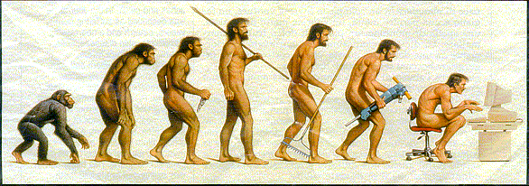
HISTROY CLASS
EVOLUTION.

Slide 2
Evolution
the gradual transformation or development of certain specie to a new form.

Slide 3
History of Computer Technology

Slide 4
From Analog to Digital Age

Slide 5
Abacus
One of the early precursors of the computer. It is an instrument containing beads used for arithmetic calculations

Slide 6
Napier's Bone
Invented by John Napier, it can perform multiplications and divisions. It contains a set of 11 sticks (bones), and are used by placing them side by side.

Slide 7
Schikard's Machine
Wilhelm Schikard, a German scientist, invented a machine in 1623 that used sprocketed wheels to add, multiply and divide.

Slide 8
Slide Rule
Developed by William Oughtred, it consists of two movable rulers placed side by side. Sliding the rulers can do multiplication and division.

Slide 9
The Pascaline
Blaise Pascal, a French Mathematician invented a calculating machine that can add and subtract and comes with eight rotating gears, with each wheel representing places in the decimal system.

Slide 10
Jacquard's Loom
Developed by Joseph Marie Jacquard, a French inventor. This machine uses punch cards to program designs on fabrics and carpets, making them easier to be woven.

Slide 11
Difference Engine
Charles Babbage, an English mathematician, built a working model of an early computer-like mechanical device that called the Difference Engine that can solve mechanical problems using the capacity of 20 decimals.

Slide 12
The Hollerith Tabulating Machine
Herman Hollerith, an American inventor, designed a coding scheme and a mechanical tabulating machine which used punch cards that can be electronically read to process high volumes of data.

Slide 13
MARK I
Developed by Howard Aiken, MARK I was the first electro-mechanical digital computing machine

Slide 14
Generations of Computer Technology

Slide 15
First Generation (1940-1956) Vacuum Tubes
The first computers used vacuum tubes for circuitry and magnetic drums for memory, and were often enormous, taking up entire rooms. They were very expensive to operate and in addition to using a great deal of electricity, generated a lot of heat, which was often the cause of malfunctions.

Slide 16
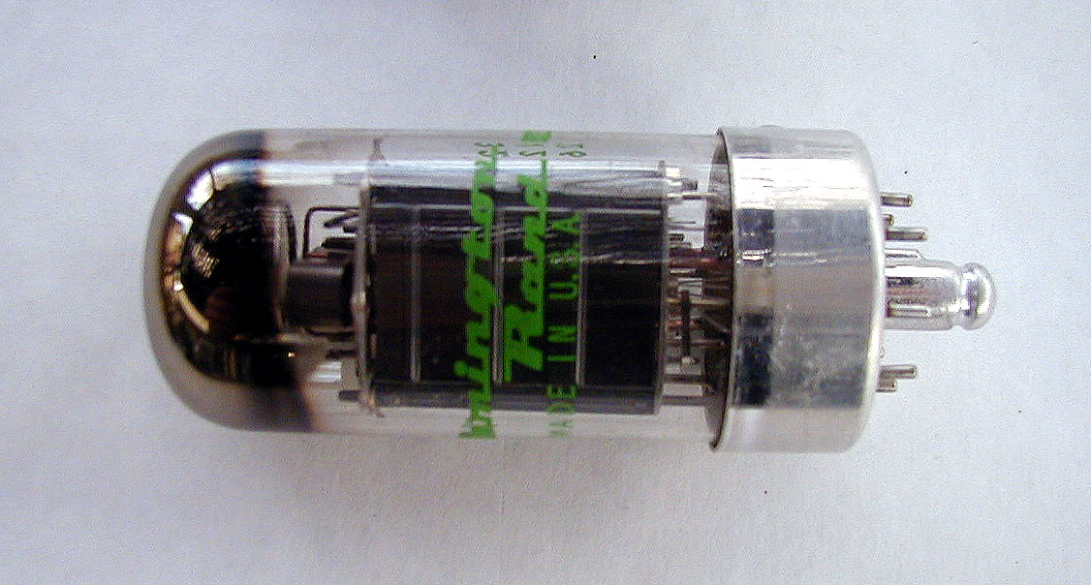
Vacuum Tube

Slide 17
Second Generation (1956-1963) Transistors
Transistors replaced vacuum tubes and ushered in the second generation of computers. The transistor was invented in 1947 but did not see widespread use in computers until the late 1950s. The transistor was far superior to the vacuum tube, allowing computers to become smaller, faster, cheaper, more energy-efficient and more reliable than their first-generation predecessors. Though the transistor still generated a great deal of heat that subjected the computer to damage, it was a vast improvement over the vacuum tube. Second-generation computers still relied on punched cards for input and printouts for output.

Slide 18
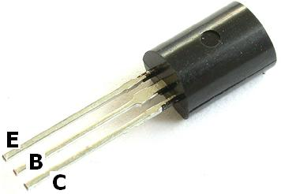
Transistor

Slide 19
Third Generation (1964-1971) Integrated Circuits or ICs
The development of the integrated circuit was the hallmark of the third generation of computers. Transistors were miniaturized and placed on silicon chips, called semiconductors, which drastically increased the speed and efficiency of computers. Instead of punched cards and printouts, users interacted with third generation computers through keyboards and monitors and interfaced with an operating system, which allowed the device to run many different applications at one time with a central program that monitored the memory. Computers for the first time became accessible to a mass audience because they were smaller and cheaper than their predecessors.

Slide 20
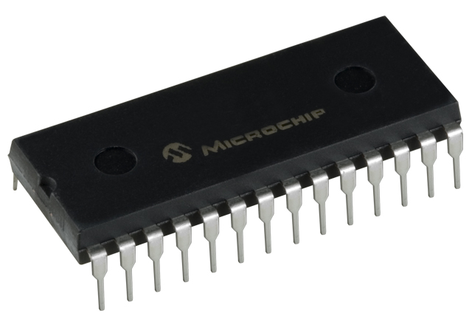
Integrated Circuit

Slide 21
Fourth Generation (1971-Present) Microprocessors
The microprocessor brought the fourth generation of computers, as thousands of integrated circuits were built onto a single silicon chip. What in the first generation filled an entire room could now fit in the palm of the hand. The Intel 4004 chip, developed in 1971, located all the components of the computer—from the central processing unit and memory to input/output controls—on a single chip.

Slide 22
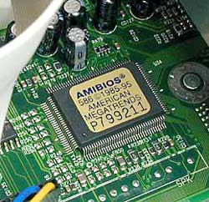
Microprocessor

Slide 23
Fifth Generation (Present and Beyond) Artificial Intelligence
Fifth generation computing devices, based on artificial intelligence, are still in development, though there are some applications, such as voice recognition, that are being used today. The use of parallel processing and superconductors is helping to make artificial intelligence a reality. Quantum computation and molecular and nanotechnology will radically change the face of computers in years to come. The goal of fifth-generation computing is to develop devices that respond to natural language input and are capable of learning and self-organization.

Slide 24
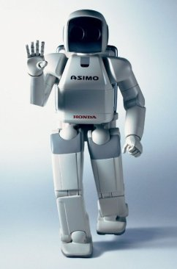
Artificial Intelligence

Slide 25
History of Computer Technology
Danny D. J. Magdaraog

